Slide 1
Leflunomide
Leflunomide conversion
Blood born degradation
Teriflunomide
2:LUNG
QCO
7:LUNG
QCO
1:GUT
KAL
8:LIVER BOUND
QH
3:LIVER
KOFF
KD = KOFF/KON
FU = 1/(1+PROT/KD)
KON
QH
KA
CLLM
9:LIVER UNBOUND
6:GUT
CLL
5:Clearance
KREABS
CLINT
11:BILE
QBILE
KE
4:BODY
12:Clearance
QBODY = QCO - QH
13:Clearance
Blood born degradation
10:BODY
QBODY = QCO - QH

Slide 2
Leflunomide conversion
Blood born degradation
Teriflunomide
3:LUNG
QCO
9:LUNG
QCO
1:GUT
KAL
QHp
2:PORTAL BLOOD
10:LIVER BOUND
QHa
4:LIVER
KOFF
KD = KOFF/KON
FU = 1/(1+PROT/KD)
KON
QHa
8:PORTAL BLOOD
CLLM
11:LIVER UNBOUND
KA
QHp
CLL
6:Clearance
KREABS
7:GUT
CLINT
13:BILE
QBILE
KE
5:BODY
14:Clearance
QBODY = QCO - QH
15:Clearance
Blood born degradation
12:BODY
QBODY = QCO - QH

Slide 3
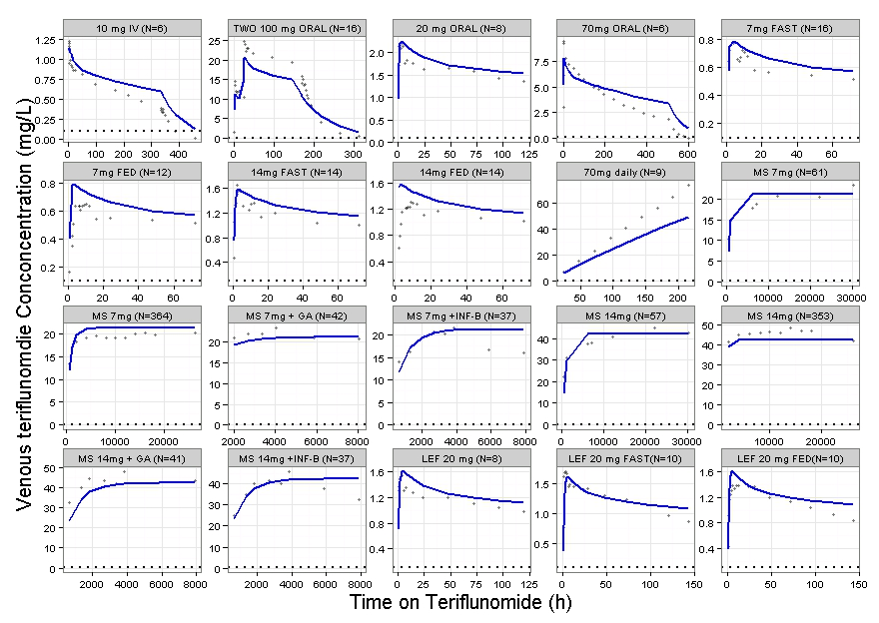
Washout
Washout
Washout

